Slide 1

Emerging Trends in
Software Engineering
1

Slide 2
Predictions
“One of the things that I think we have learned is that we should all be very careful about making predictions about the future.” Bill Clinton, 42nd President of the USA
For example:
“I think there is a world market for maybe five computers.” Thomas Watson, chairman of IBM, 1943
“There is no reason anyone would want a computer in their home.” Ken Olson, President, Chairman of Digital Equipment Corp., 1977
“640K ought to be enough for anybody.” Bill Gates, chairman of Microsoft, 1981
2

Slide 3
The Big Picture
Software intensive systems (SIS) have become the foundation of virtually every modern technology.
Software content in virtually every product and service will continue to grow—in some cases dramatically
Software must be demonstrably safe, secure, and reliable
Requirements will emerge as systems evolve
Interoperability and “networkability” will become dominant as “mash-ups” become the norm
A “smart world” demands better, more reliable software
3

Slide 4
A Harsh Reality
The challenges facing software engineers will get no easier as we move into the second decade of the 21st century
New process models, methods, languages, and tools will emerge,
But …
There is no silver bullet!
4

Slide 5
Software Intensive Systems (SIS)
Software System
engineering engineering
Increasing integration of software engineering and system engineering activities
Increasing emphasis on users and end-value
Increasing SIS criticality and dependability
Increasing need to manage rapid change
Increasing project/product globalization and need for interoperability
Increasing size and complexity
Increasing software “autonomy” (apps that independently evaluate their environment and choose a course of action that is appropriate)
Barry Boehm
5

Slide 6
Technology “Evolution”
Ray Kurzweil argues that technological evolution is similar to biological evolution, but occurs at a rate that is orders of magnitude faster.
“ … the more capable methods resulting from one stage of evolutionary progress are used to create the next stage.” [Kurweil, R., The Singularity is Near, 2005]
What are “the more capable [process and] methods [and tools]” for software engineering?
6

Slide 7
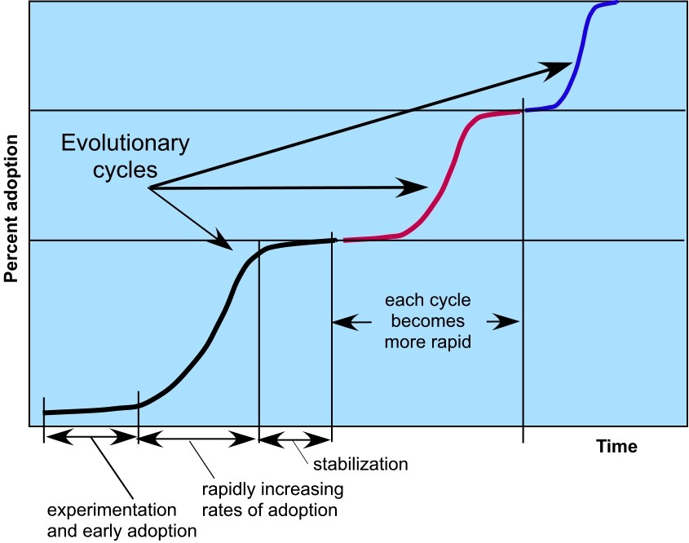
Idealized Technology Innovation Lifecycle
7

Slide 8
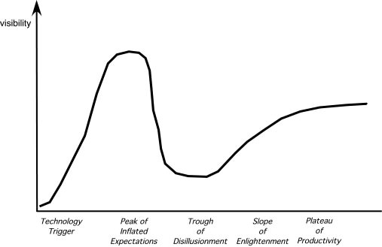
The Hype Cycle
Gartner Group,
2008
8

Slide 9

Software Engineering Trends
Soft Trends
The broad characteristics of the new systems we build (and test), e.g.,
Emergent requirements
Autonomy of action
The anthropological and sociological characteristics of the new generation of people who do software engineering work
Hard Trends
The technical aspects of next generation software intensive systems
The technical directions that software engineering process, methods, and tools will take

Slide 10
Soft Trends - I
Connectivity and collaboration (enabled by high bandwidth communication)
software teams that do not occupy the same physical space (telecommuting and part-time employment in a local context).
Globalization leads to a diverse workforce
in terms of language, culture, problem resolution, management philosophy, communication priorities, and person-to-person interaction
An aging population implies that many experienced software engineers and managers will be leaving the field over the coming decade
We need viable mechanisms that capture the knowledge of these aging managers and technologists
Consumer spending in emerging economies will double to well over $9 trillion.
Some of this spending will be applied to products and services that have a digital component that is software-based

Slide 11
Software Trends - II
People and Teams
As systems grow in size, teams grow in number, geographical distribution, and culture
As systems grow in complexity, team interfaces become pivotal to success
As systems become pervasive, teams must manage emergent requirements
As systems become more open, what is a team?

Slide 12
Managing Size & Complexity - I
In the relatively near future, systems requiring over 1 billion LOC will begin to emerge
Consider the interfaces for a billion LOC system
to the outside world
to other interoperable systems
to the Internet (or its successor), and
to the millions of internal components that must all work together to make this computing monster operate successfully.
How do we manage the project, the teams, the communication among software engineers?

Slide 13
Managing Size & Complexity - II
From a testing perspective:
Is there a viable way to validate requirements?
Is there a reasonable way to conduct technical reviews and communicate their results across hundreds of teams?
Is there a reliable way to ensure that all of the interfaces will allow information to flow properly?
Is there a realistic strategy for conducting tests, tracking errors, and performing debugging?
Is there an efficient way to perform regression tests?
How do you conduct performance tests, stress tests, and security tests when the system is huge?

Slide 14
Pervasive Computing (PvC)
Concepts such as ambient intelligence, context-aware applications, and ubiquitous computing—all focus on integrating software-
based systems into an environment far broader
than anything to date
Open-world software—software that is designed to adapt to a continually changing environment ‘by self-organizing its structure and self-adapting its behavior.” *
* Baresi, L., E. DiNitto, and C. Ghezzi, “Toward Open-World Software: Issues and Challenges,” IEEE Computer, October 2006.

Slide 15
Pervasive Computing (PvC)
First stage (PvC-1) [today]
Device mobility and ad hoc networking
Simple context awareness
Soon: smart objects implemented in devices that have the potential to communicate with one another
Second stage (PvC-2) [over the next decade]
Mobile user profiles that can be recognized by other objects
Smart objects will respond to other objects based on situational characteristics
Testing issues
Considerable environmental variation
Complex communication issues
Adaptive processing requirements

Slide 16



Cloud Computing
"Cloud Computing is a paradigm in which
information is permanently stored in servers on the Internet and cached
temporarily on clients that include
Cloud clients
desktops, entertainment centers, table computers, notebooks, wall computers, handhelds, sensors, monitors, etc.” IEEE Internet Computing
Provides software as a service (SaaS)
Device and location independence
Cloud architecture
enables users to access systems regardless of their location or device
Multi-tenancy enables sharing of resources (and costs) among a large pool
of users
Legacy Infrastructure
Demands reliability, scalability, security,
sustainability (Green IT)

Slide 17
Emergent Requirements
As systems become more complex, requirements will emerge as everyone learns more about:
The system’s interoperable elements
The environment in which it is to reside, and
The objects that interact with it.
This reality implies a number of software engineering trends.
Software process agility—embracing change
Judicious use of modeling methods—models will change repeatedly as more knowledge about the system is acquired
Tools that make adaptation and change easier

Slide 18
Software Building Blocks
“merchant software”—software building blocks designed specifically for a unique application domain (e.g., VoIP devices).
The software engineering issue:
“Component trust”
Testing Issues:
Evaluating/Certifying a component validation suite
Establishing trust using component testing
Integrating using deployment testing
Validating using system testing

Slide 19
Open Source
“Open source is a development method for software that harnesses the power of distributed peer review and transparency of process. The promise of open source is better quality, higher reliability, more flexibility, lower cost, and an end to predatory vendor lock-in.” *
The term open source when applied to computer software, implies that software engineering work products (models, source code, test suites) are open to the public and can be reviewed and extended (with controls) by anyone with interest and permission.
* OpenSource.org, 2008, available at www.opensource.org/.

Slide 20
Testing Open Source
Functionality is added regularly as the software evolves
It must be tested asap
Refactoring occurs continually
The behavior of the software after refactoring must be tested
Application code and test code (suites) must evolve simultaneously (“co-evolve”)
To manage testing in an open source environment, we must examine the application in three different “dimensions” *
The change history view
The growth history view
The coverage/evolution view
* Zaidman, A., et al, “On how developers test open source software systems” available at citeseerx.ist.psu.edu, 2007.

Slide 21

Software Engineering Trends
Ivar Jacobson identifies four major trends:
Reusable components—stop reinventing the wheel
More up-front testing—test-
Tools
driven development
Platform transparency—
reduce today’s programming
Methods
complexity
UML “all the way down”— model-driven development
Process

Slide 22
SE Trends—Process
Agility
Tools
Adaptability
Collaboration
Communication
Methods
ROI
Process

Slide 23
Process Trends
SPI frameworks will emphasize “strategies that focus on goal orientation and product innovation.” [Con02]
Process changes will be driven by the needs of practitioners and should start from the bottom up.
Greater emphasis will be placed on the return-on-investment of SPI activities.
Expertise in sociology and anthropology may have as much or more to do with successful SPI as other, more technical disciplines.
New modes of learning may facilitate the transition to a more effective software process.
Automated software process technology (SPT) will move away from global process management (broad-based support of the entire software process) to focus on those aspects of the software process that can best benefit from automation.

Slide 24
Collaborative Development
Today, software engineers collaborate across time zones and international boundaries, and every one of them must share information.
The challenge over the next decade is to develop methods and tools that facilitate that collaboration.
Critical success factors:
Shared project goals
Shared project culture
Shared process
Shared responsibility

Slide 25

SE Trends—Methods
In RE
In design
TToooolsls
In languages
In testing
In SCM/SQA
Methods
Process

Slide 26
Methods: The Grand Challenge
The engineering of large, complex systems, regardless of delivery platform or application domain, the poses the “grand challenge” * for software engineers.
Key approaches:
more effective distributed and collaborative software engineering process models
better requirements engineering approaches
a more robust approach to model-driven development, and
better software tools
* Broy. M., “The Grand Challenge,” IEEE Computer, Oct., 2006.

Slide 27
Requirements Engineering
The software engineering community will likely implement three distinct sub-processes as RE is conducted:*
improved knowledge acquisition and knowledge sharing that allows more complete understanding of application domain constraints and stakeholder needs
greater emphasis on iteration as requirements are defined
more effective communication and coordination tools that enable all stakeholders to collaborate effectively.
* Glinz, M., and R. Wieringa, “Stakeholders in Requirements Engineering,” IEEE Software, March– April 2007.

Slide 28
Model-Driven Development
MDD couples domain-specific modeling languages with transformation engines and generators in a way that facilitates the representation of abstraction at high levels and then transforms it into lower levels
Domain-specific modeling languages (DSMLs)
represent “application structure, behavior and requirements within particular application domains”
described with metamodels that “define the relationships among concepts in the domain and precisely specify the key semantics and constraints associated with these domain concepts.” *
* Schmidt, D.,”Model-Driven Engineering,” IEEE Computer, February 2006.
28

Slide 29
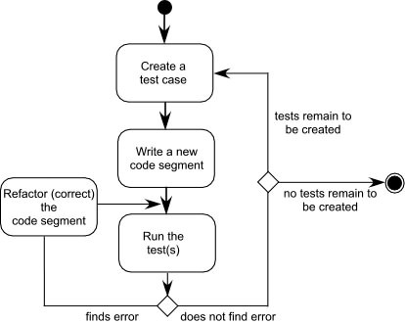
Test-Driven Development
In test-driven development (TDD), requirements for a software component serve as the basis for the creation of a series of test cases that exercise the interface and attempt to find errors in the data structures and functionality delivered by the component.
TDD is not really a new technology but rather a trend that emphasizes the design of test cases before the creation of source code. Continues to emphasize the importance of software architecture.
29

Slide 30

Service-Orietn ed Development
Strives to create models that can be understood by individuals with diverse levels of business and technical understanding.
The service-oriented modeling paradigm advocates taking a holistic view of the analysis, design, and architecture of all 'Software Entities' in an organization.
Service-oriented modeling encourages viewing software entities as 'assets' (service-oriented assets), and refers to these assets collectively as 'services'.
Atomic service
Composite service
Service Cluster
30

Slide 31

Aspect-Oriented Development
Concerns—customer required
properties or areas of technical
Cross-
interest
Cutting
Cross cutting concerns—concerns
Concern
cut across multiple system functions, features, and information
AOD provides a process and methodological approach for defining, specifying, designing, and constructing aspects— mechanisms beyond subroutines and inheritance for localizing the expression of a crosscutting concern
Requirements
31

Slide 32
SE Trends—Tools
Project mgmt. Modeling
TToooolsls
Programming
Testing Maintenance
Methods
SCM SEEs
Process
32

Slide 33
Tools Trends—RE and Modeling
Requirements engineering tools will combine voice recognition input with “text mining” to extract requirements from informal information sources
As pervasive computing becomes commonplace, design modeling tools must allow the designer to consider the architecture and behavior of the software and the physical properties of the devices on which the software resides
33

Slide 34
Tools Trends—Testing
As test-driven development approaches gain momentum, tools for selecting test cases based on requirements and/or models must be developed. In addition, the software engineering community needs better tools for:
Launching selected tests in multiple device environments
Assessing the test outcome (sometimes called a “test oracle”)
Evaluating the impact of failures and determining the root cause of the failure
Determining whether the testing regime is sufficient
34

Slide 35
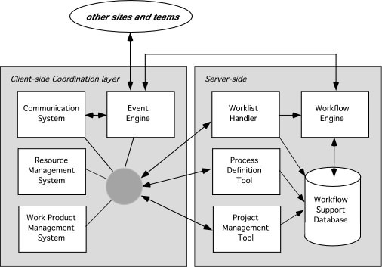
Tools Trends—SEE
35

Slide 36
The Road Ahead
“We're driving faster and faster into the future, trying to steer by using only the rear-view mirror.” Marshall McLuhan
“Artificial intelligence is about at the same place the personal computer industry was in 1978.” BBC News
Prediction by consensus: similar to
www.hubdub.com
“…the best way to predict the future is to invent it.” Alan Kay
36

